Slide 1
ATROPHIC VAGINITIS SENILE VAGINITIS
Dr Shanthi Serene Sylum V
Professor and Head
Dept. Obstetrics and Gynaecology
SKHMC Kulasekharam

Slide 2
Vaginitis in postmenopausal women is called
atrophic vaginitis. The term is preferable to senile
vaginitis.

Slide 3
There is atrophy of the vulvovaginal structures
due to estrogen deficiency. The vaginal defence is
lost. Vaginal mucosa is thin and is more susceptible
to infection and trauma. There may be desquamation
of the vaginal epithelium which may lead to formation
of adhesions and bands between the walls.

Slide 4
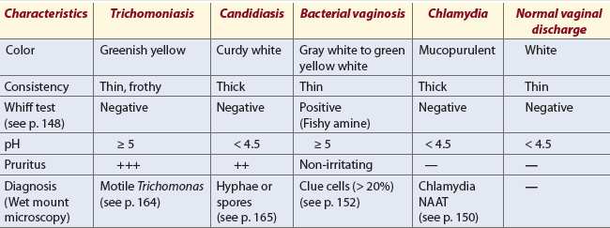
Differential diagnosis of vaginal discharge

Slide 5
Clinical Features
(a) Yellowish or blood stained vaginal discharge.
(b) Discomfort, dryness, soreness in the vulva.
(c) Dyspareunia.
On examination
(a) Evidences of pruritus vulvae.
(b) Vaginal examination is often painful and the walls
are found inflamed.

Slide 6
Diagnosis
Senile endometritis may co-exist and carcinoma body or the cervix should be excluded prior to therapy.
Treatment
Improvement of general health and treatment of infection if present
Systemic estrogen therapy may be considered if there is no contraindication. This improves the vaginal epithelium, raises glycogen content, and lowers vaginal pH.
Intravaginal application of estrogen cream by an applicator is also effective.

Slide 7
DC Dutta’s Textbook of Gynecology including Contraception Enlarged & Revised Reprint of Sixth Edition Edited by Hiralal Conar November 2013 JAYPEE.

Slide 8
Thank you

